Slide 1
Analysing Crime and Venue Data in London Boroughs
Lucie Shortland

Slide 2
Introduction
Crime rates in London have increased by over 23% from 2015-2020
15,590 knife crimes were reported across London from 2019-2020
Real estate agents and individuals should be aware of crime rates when looking at residential property in London
BUSINESS PROBLEM: which parts of London are safe and attractive for residential buyers/renters across various demographic groups?

Slide 3
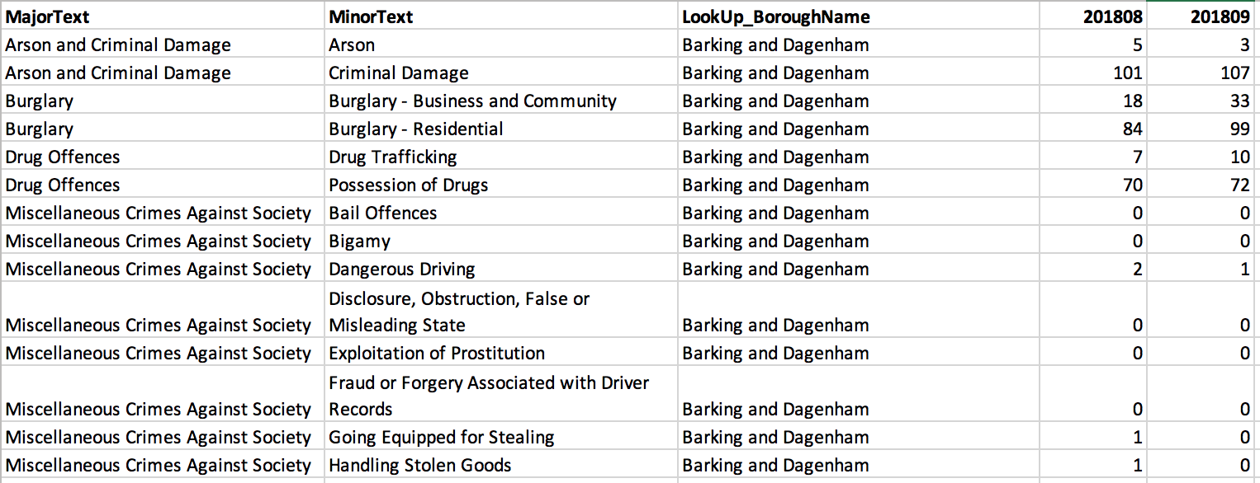
Data
Metropolitan Police Service (MPS) Borough Level Crime from August 2018 to July 2020 (https://data.london.gov.uk)
Foursquare venue data

Slide 4
Methodology
Downloading and exploring the dataset
Exploring neighborhoods in London
Analysing each neighbourhood
Clustering neighborhoods
Examining clusters

Slide 5
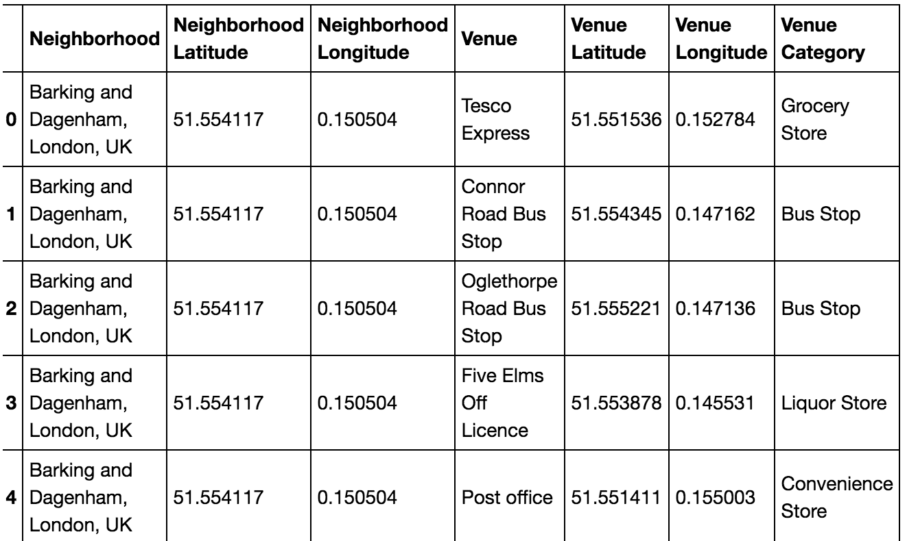
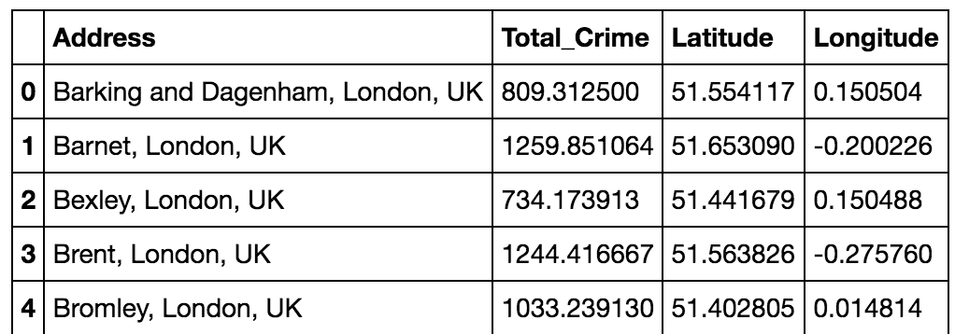
Steps I. and II.

Slide 6
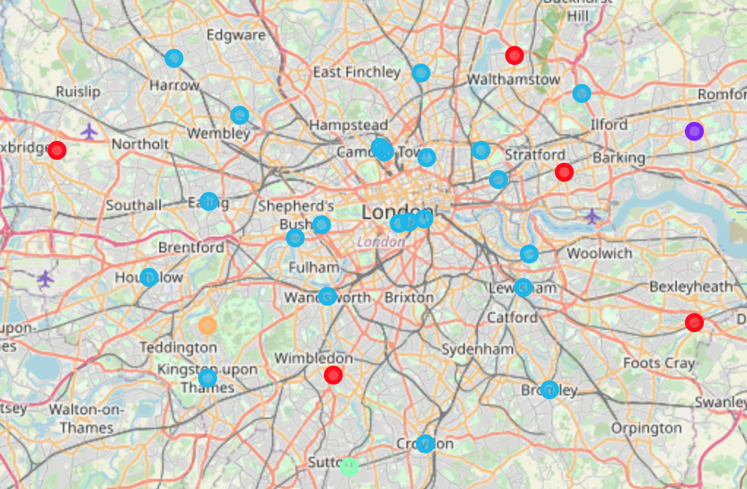
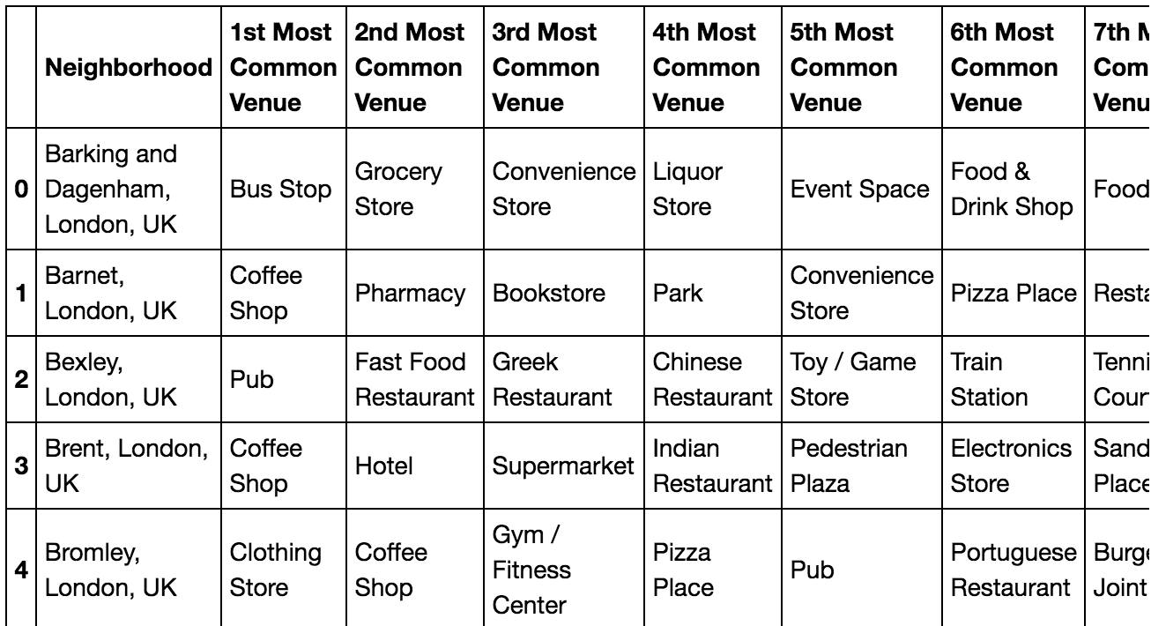
Steps III. and IV.

Slide 7
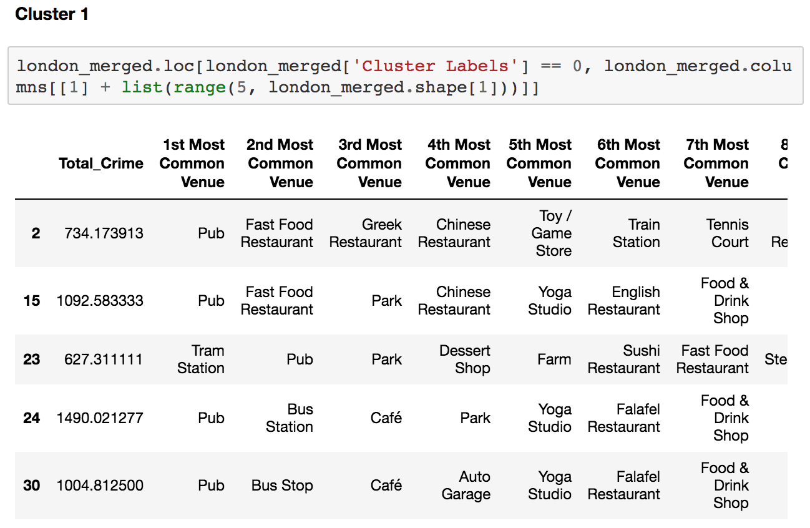
Step V.

Slide 8
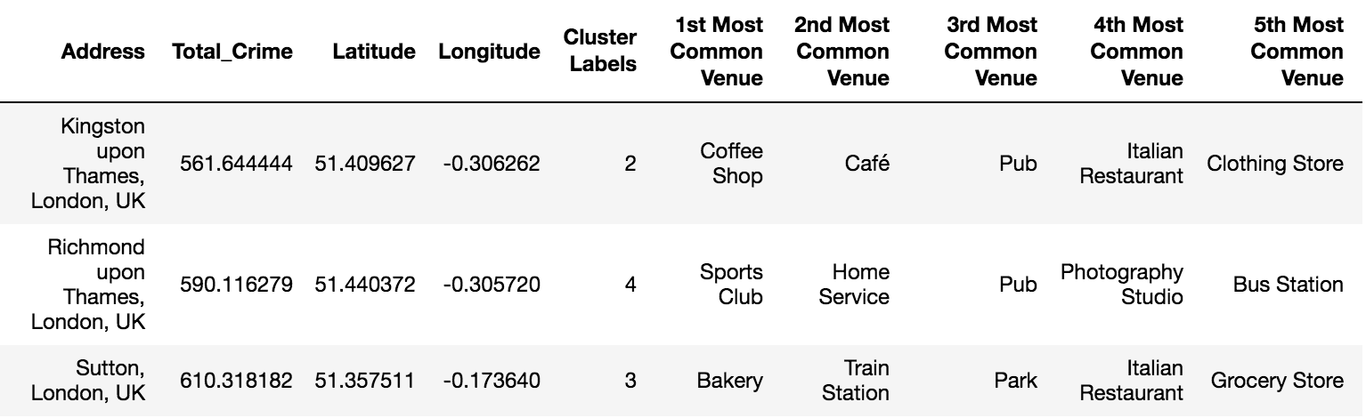
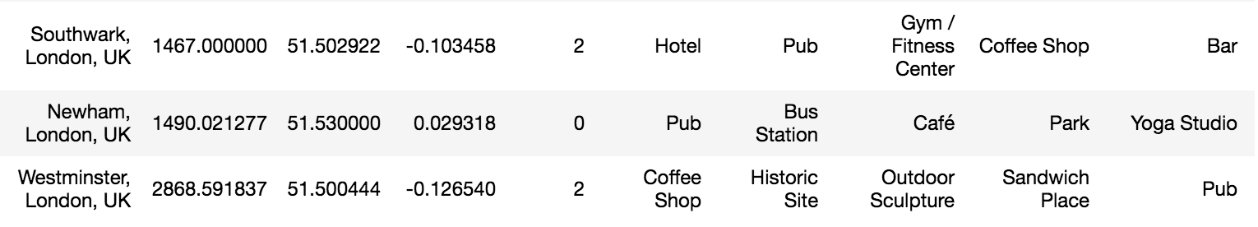
Summary of Data
Three safest boroughs
Three least safe boroughs

Slide 9
Results
The most common venues were as follows: Cluster 1 – Pubs, fast food restaurants, parks. Cluster 2 – Bus stops, grocery stores, convenience stores. Cluster 3 – Coffee shops, pubs and clothing stores. Cluster 4 – Bakeries, train stations, parks. Cluster 5 – Sports clubs, home services, pubs.
Students / young professionals
Less attractive
Families and older people

Slide 10
Conclusion
Sutton and Richmond are attractive for family homes and older people.
Merton and Bexley are appropriate for younger residential buyers/renters with more pubs, fast food restaurants and parks.
Kingston upon Thames and Harrow are ideal for families and older people.
Barking and Dagenham is safe but less attractive for buyers/renters.

